Slide 1

BIG DATA Passed, Future and Conditional
Cedric Notredame CRG, Barcelona

Slide 3
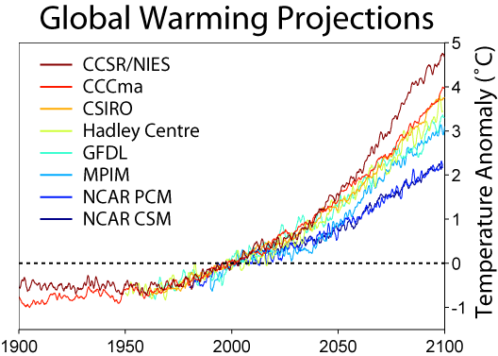

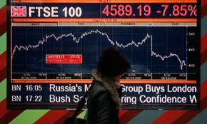
BIG DATA To Predict

Slide 4
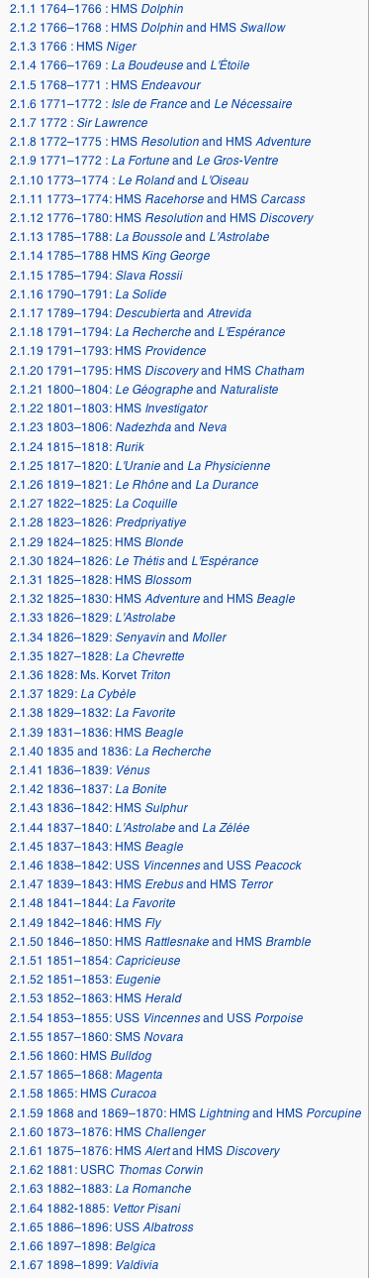
Big Old Data, Big Old Findings
1836
1859

Slide 5
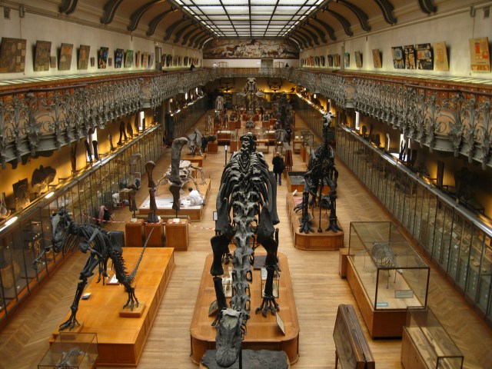
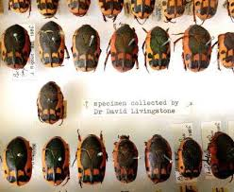
Mega-bricks Full of Bugs

Slide 6
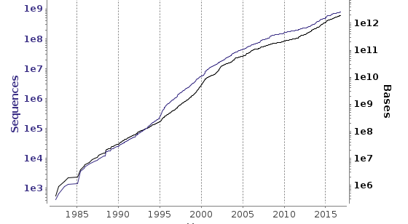
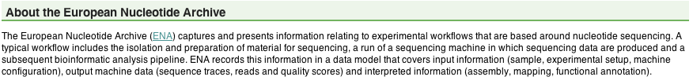
New Big Data

Slide 7
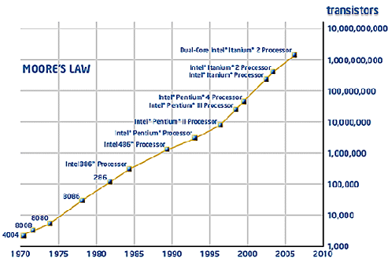
Moore’s Law

Slide 8
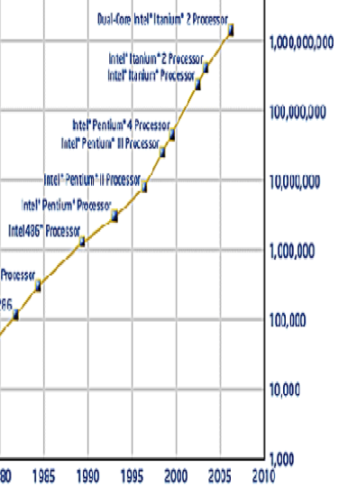
Moore’s Law vs NGS Law

Slide 9
More Money
OR
Better Algorithms
…

Slide 10

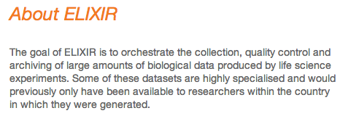

Slide 11
What does this massive amount of data imply for Biology?

Slide 12
The End of Theory?
Wikipedia says:
Theories are analytical tools for understanding, explaining, and making predictions about a given subject matter. There are theories in many and varied fields of study, including the arts and sciences.

Slide 13
The End of Theory?
Wikipedia says:
Theories are analytical tools for understanding, explaining, and making PREDICTIONS about a given subject matter. There are theories in many and varied fields of study, including the arts and sciences.

Slide 14
Have We Passed the Prediction Peak?

Slide 15
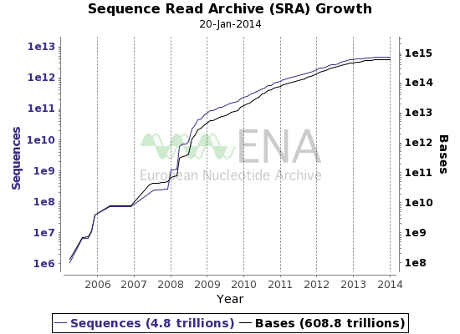
Maybe…
2008: The year Databases Stopped Growing Exponentially!!!
In 2008 Data started doubling in size a little bit faster every year (for a while)
Super-exponential

Slide 16
With Small Data, Predicting is The Main ISSUE
With BIG DATA the ISSUE is to Recognize SIGNAL

Slide 17
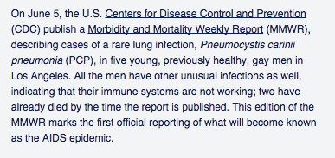
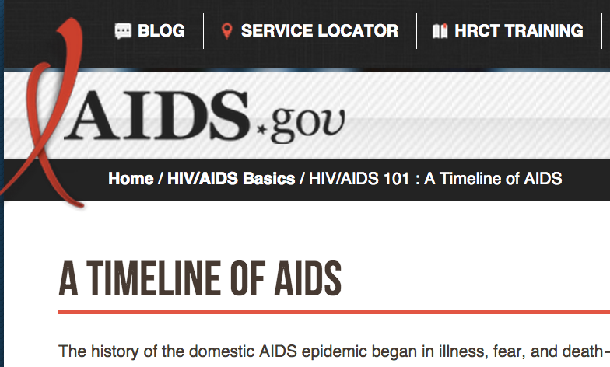
BIG DATA has always been Around

Slide 18
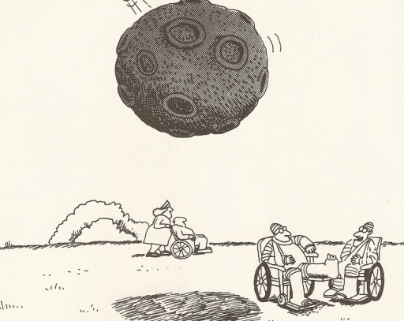
You won’t believe it. I was hit twice by thunder too !!!
Garry Larson, The Far Side

Slide 19
The New Thing
In
Big Data
Is
That
There is more to
COMPARE

Slide 20
We Need Big Data to Know What is
NORMAL
and
ABNORMAL

Slide 21
Predictions
With
BIG DATA
can be
TRICKY

Slide 22
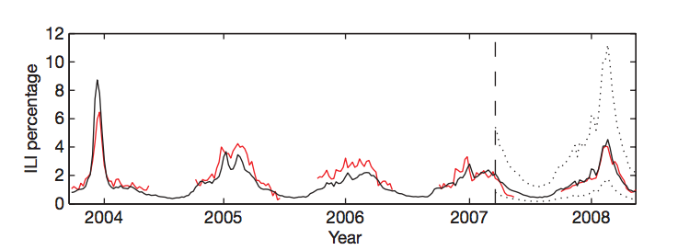
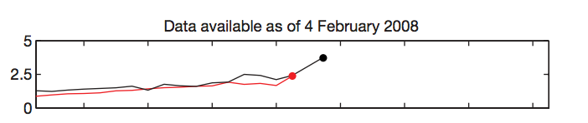
Google Can Predict the Next Flu

Slide 23
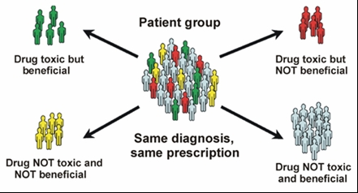
Your GENOME is BIG DATA
http://sitemaker.umich.edu/hbhe669final/personalized_medicine

Slide 24
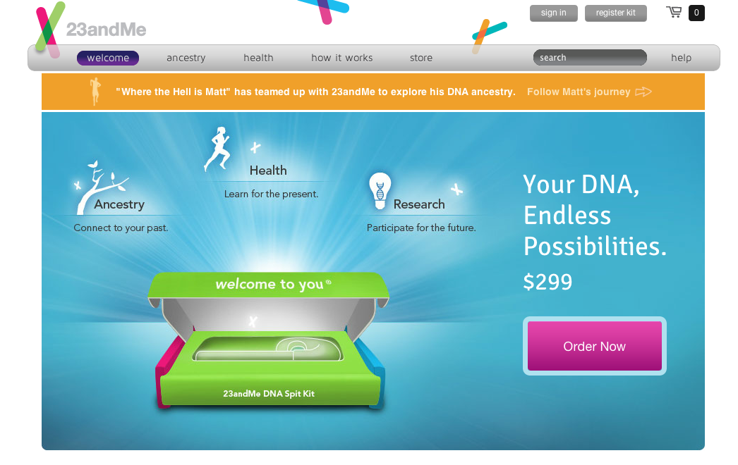
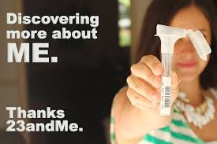

Slide 25

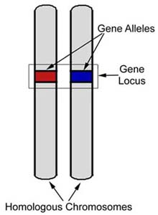
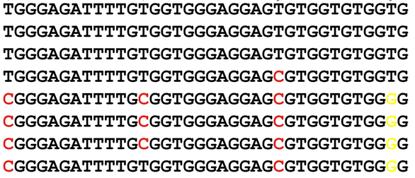

Slide 26
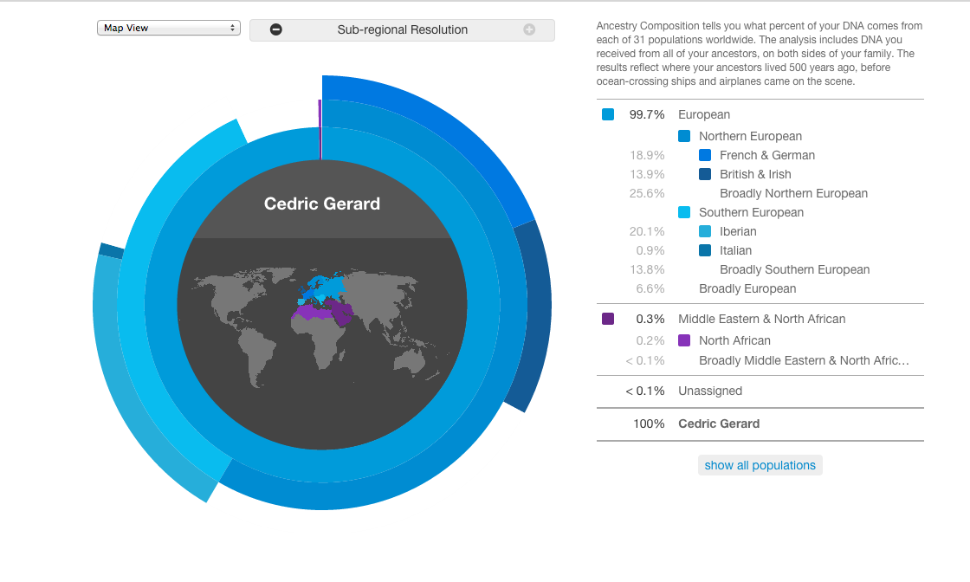

Slide 27
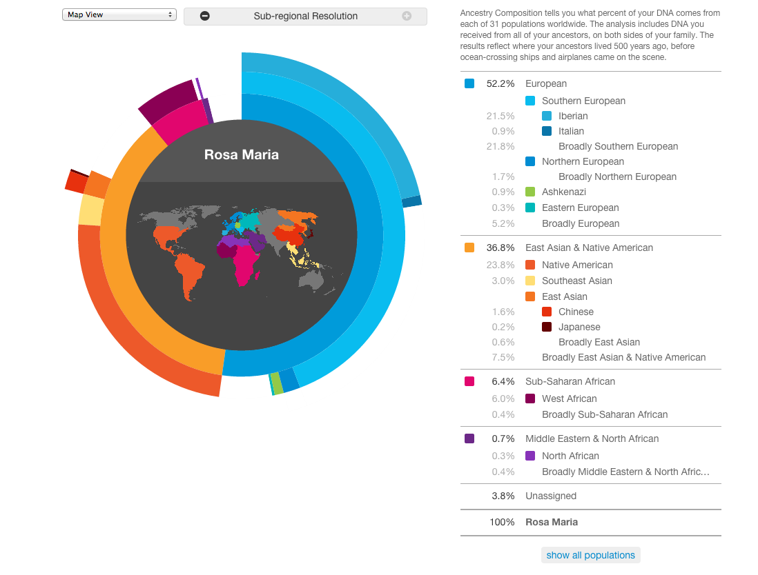

Slide 28
And Diseases ?

Slide 29
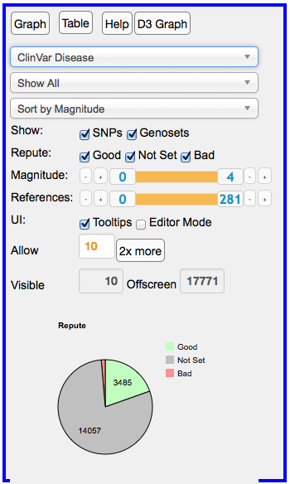

Slide 30
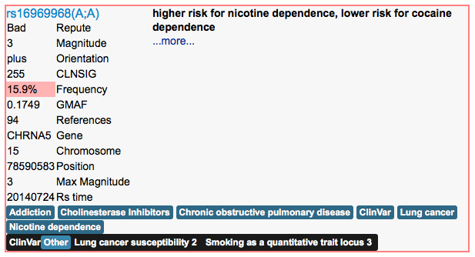

Slide 31
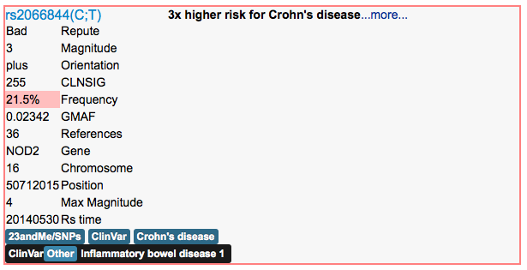

Slide 32
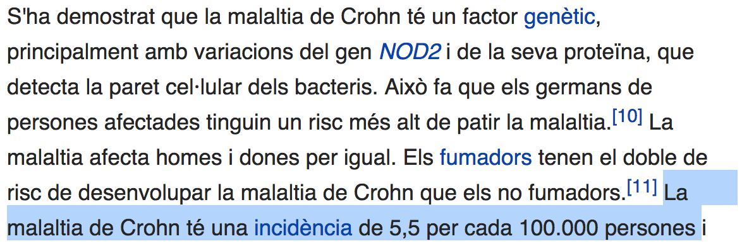

Slide 33
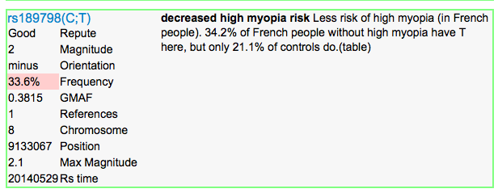
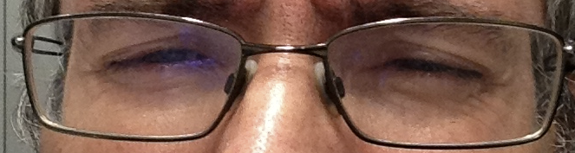

Slide 34
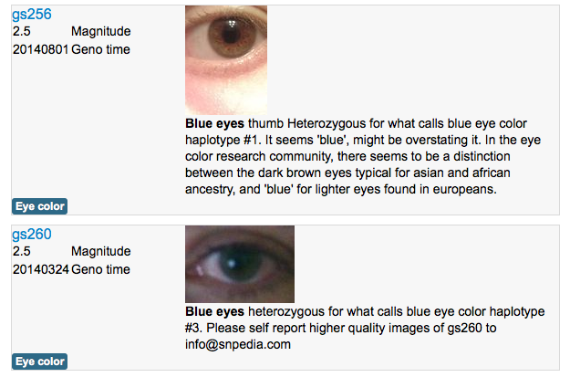

Slide 35
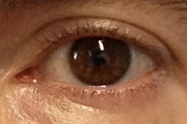

Slide 36

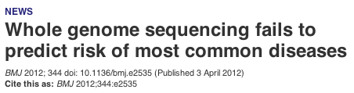
And Then ?

Slide 37
Does Genetics Work
YES or NO
???

Slide 38
Now and Then
Courtesy Arcadi Navarro

Slide 39
Sometimes The Science Behind is … mhhhhh how to put it …

Slide 40
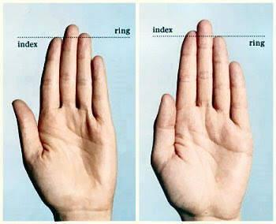
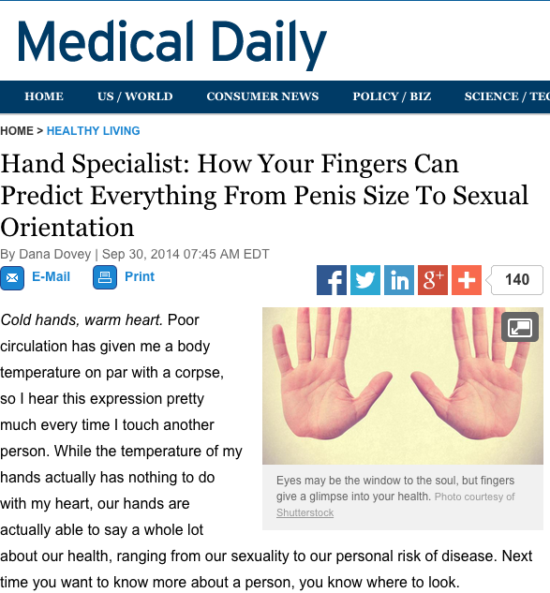

2D:4D Ratio

Slide 41
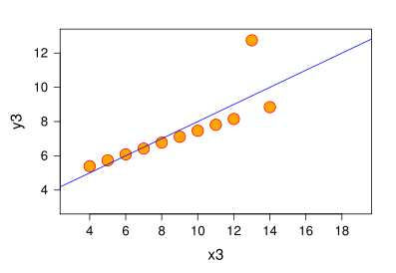
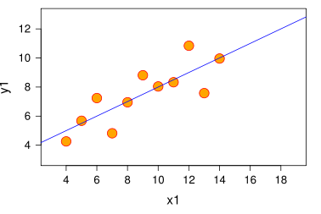

Suspiciously
Good
Correlation
Happy PI

Slide 42
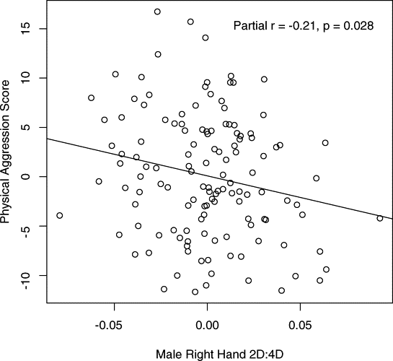
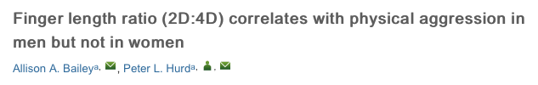
Mhhhhh

Slide 43
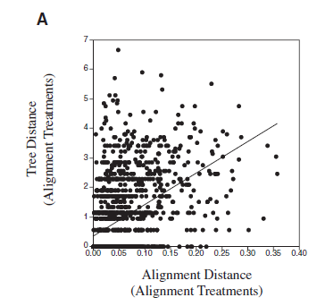
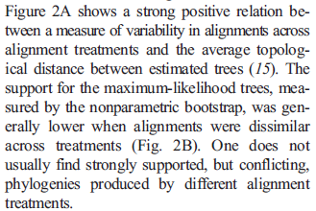
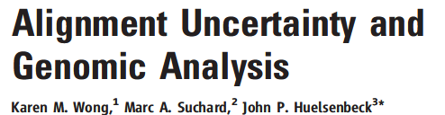
Even in BIG Journals… Can Have Problems With Correlation

Slide 44
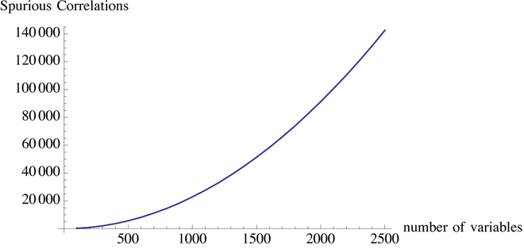
With Big Data It is even easier to find spurious correlations
This is the tragedy of big data: The more variables, the more correlations that can show significance. Source: N.N. Taleb “Antfragile”. 2012. Random House Inc

Slide 45
Multiple Sampling
If you look hard enough you always find a bit of HAY that looks like a NEEDLE
“..correlation did not survive Bonferroni correction…”

Slide 46
So What Genetics Works YES or NO ?

Slide 47

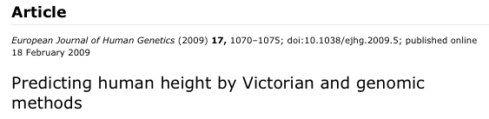

Predicting your height with Facebook +/- 5 cm
Predicting with 23andMe +/- 30 cm…

Slide 48
WHY ???

Slide 49


Slide 50
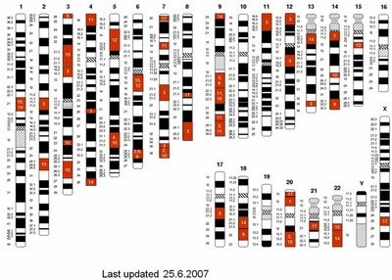
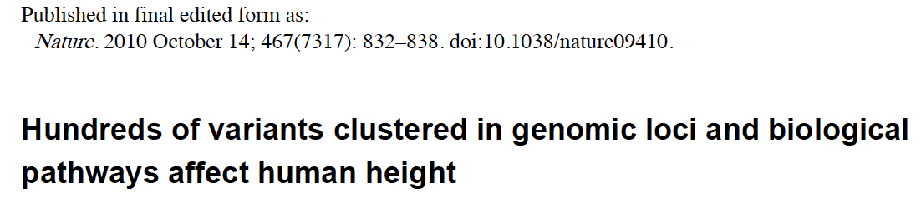
There Are Very Many Height Genes…

Slide 51
One Single Number Describes Too Many Things Variance is spread across Too many Genes DATA IS UNDERPOWERED!!!

Slide 52
Genome Wide Association Studies GWAS is an attempt to address this problem

Slide 53
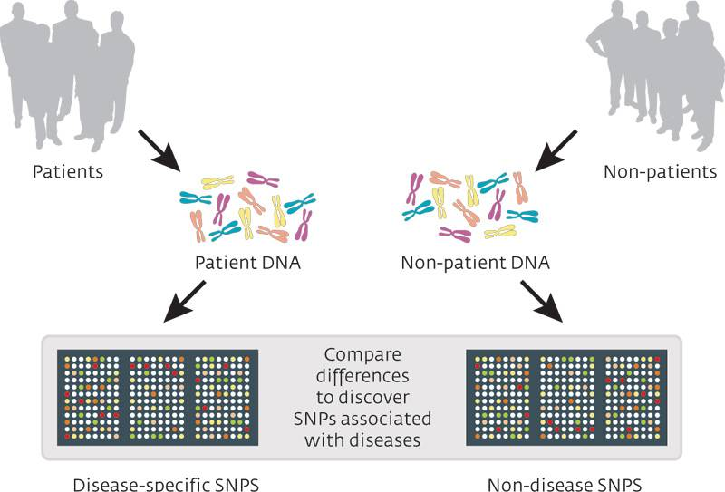

Slide 54
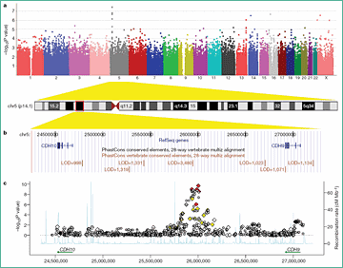

Slide 55
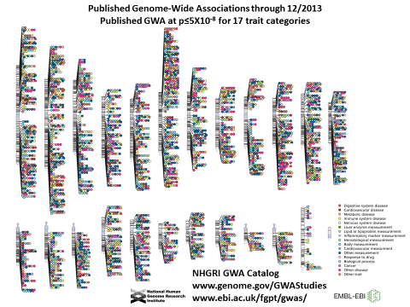
There are now 1,000s of such associations
Courtesy Arcadi Navarro

Slide 56

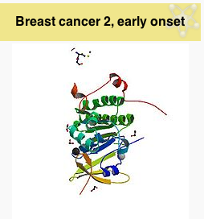
Some Cases are very Useful

Slide 57



Slide 58
But To Understand Better We need Much Much More Data!

Slide 59
More Data… Where From ?

Slide 60
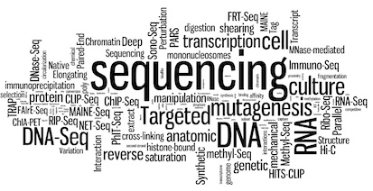

Mas Data ?

Slide 61
At the CRG
2008: 200 Million nuc. / day
2016: 200 000 Million nuc. / day
100 000% increase in 5 years…

Slide 62

Long Non Coding RNAs

Slide 63
ENSEMBL 2008

Slide 64

ENSEMBL 2016 The Lines have Crossed (in 2012)

Slide 65

Nucleosome Positioning

Slide 66

NORMAL TRANSCRIPTOME
Courtesy Roderic Guigo

Slide 67
Big Data ever Bigger?
No Reason it should stop
-Machines capacity is doubling every 10 months
-Appetite for data is increasing at the same pace
-Sampling space is nearly infinite
Theory falsification is easier than ever

Slide 68
Scientist
Speciation
Under
Big Data
Pressure

Slide 69


Stamp Collectors and Physicists

Slide 70
Collaborative Projects
ENCODE
GTEX
BluePrint
International Cancer Project (Including CLL)
Geuvadis
Quantomics
1000 Genomes: A deep catalogue of Human Genetic Variation
The Human Microbiome Project
Tara and the rest

Slide 71

The End of Model Systems as we knew them

Slide 72




Where Will Big Data Come From ?

Slide 73

Where is it happening?

Slide 74
What Next?
Comparing Data is the next Big Issue
Model Systems are too far apart
Intermediate organism need to be used to fill the gaps
Methods do not scale well
Their performances and accuracy degrade fast
Computational deployment is non trivial
Storage is non trivial

Slide 75


What Shall we do ?
Find ways to consolidate the data
Next decades will be data driven and therefore IT infra-structure driven
Community is racing for stamps

Slide 76


The Challenge for Methods

Slide 77
With Genomes Solved What is The Next Challenge?

Slide 78



Slide 79


Longitudinal Recordings

Slide 80


Sleep Monitor Smartphone App

Slide 81

GPS ⬄ Location, Movements
Sensors ⬄ Heart Beat, Blood Pressure, Temperature
Usage ⬄ Cognitive state

Slide 82


Slide 83



Slide 84


Your Guts and your Weight

Slide 85

Cancer and Chronic Inflammation

Slide 86
Where Will We Get Data From
Simple….

Slide 87

Your Guts Know Better

Slide 88




Slide 89
Industrial Medicine is our Future

Slide 90

When in a plane, Do you want to hear ”Today You are Lucky, we have a good pilote!”

Slide 91
Same with your Medic!

Slide 92
-Discover New Diseases -Monitor Diseases -Measure the Effect of New Medecines
BIG DATA

Slide 93


Slide 94


Slide 95
PROTECTING Data is difficult We must protect its USAGE This is a question of SOCIETY

Slide 96
Ebola

Slide 97



And the Future of EBOLA

Slide 98

BIG DATA, EBOLA and your Mobile phone

Slide 99

And Then?

Slide 100
Y ahora?

Slide 101

Y ahora?

Slide 102

Optimism in a model

Slide 103

Modeling Optimism

Slide 104

Modeling Pessimism

Slide 105



Sometimes BIG DATA = BIG MYSTAKES

Slide 106
Ebola

Slide 107


So there is plenty of info… but is it reliable?
June 2007, publication of the WTCCC
Courtesy Arcadi Navarro

Slide 108
Contrary to candidate-gene association studies GWAS
have produced replicable results
Courtesy Arcadi Navarro

Slide 109

GWAS results
-variance explained-
seems to increase with time
results [From Rodriguez et al 2014. Current opinion in genetics & development 29, 97-102]
Courtesy Arcadi Navarro

